Slide 1



CAMPUS NAVIGATION SYSTEM
By : Shasmeen Syed Thameem
Sherin Katherina D

Slide 2
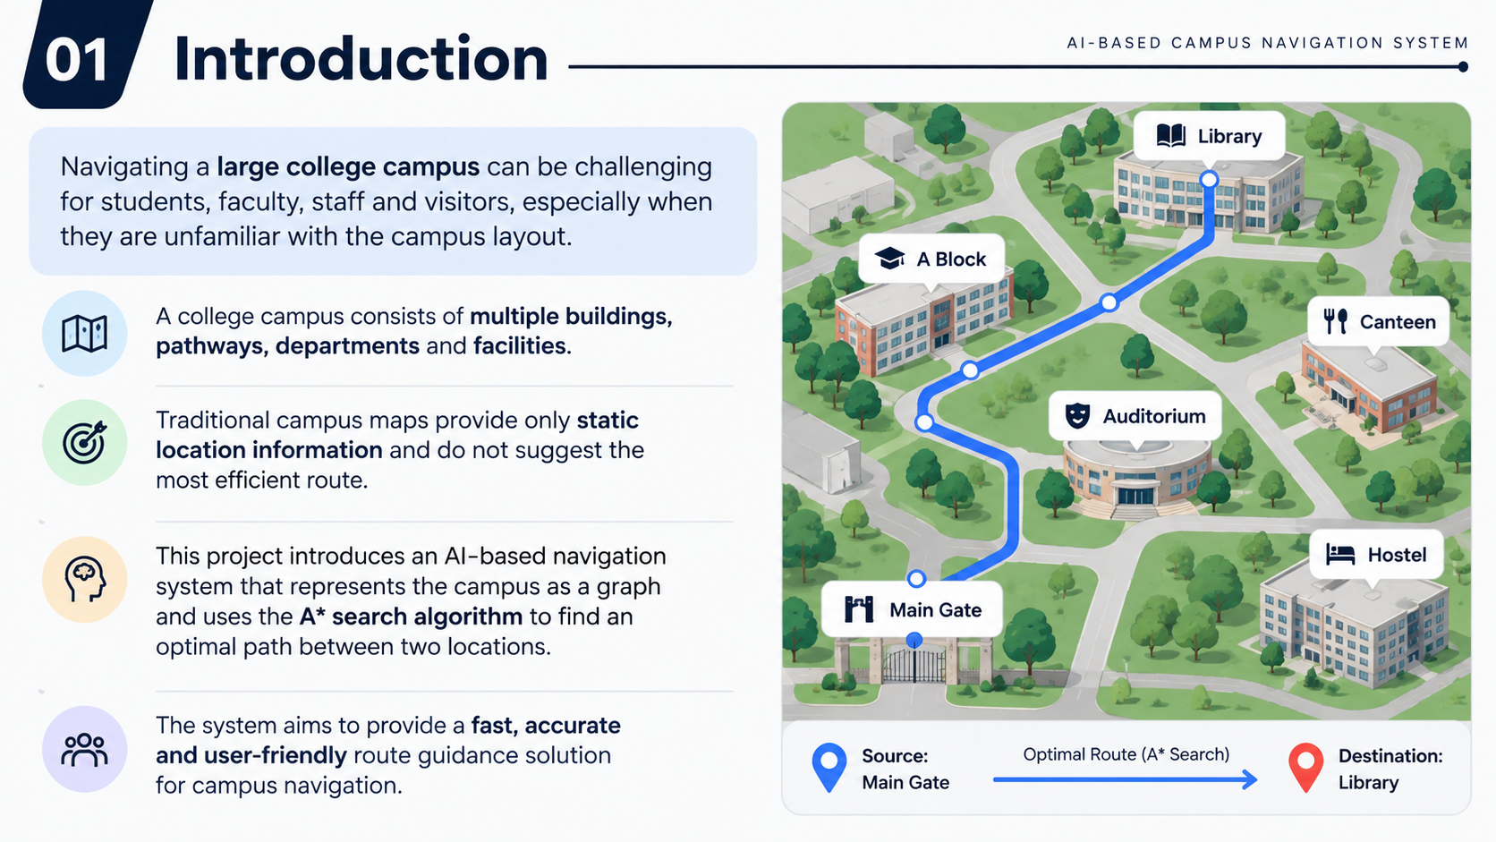
INTRODUCTION
Navigating a large college campus can be challenging for students, faculty, staff, and visitors, especially when they are unfamiliar with the campus layout.
A college campus consists of multiple buildings, pathways, departments, and facilities.
Traditional campus maps provide only static location information and do not suggest the most efficient route.
This project introduces an AI-based navigation system that represents the campus as a graph and uses the A* SearchAlgorithm to find an optimal path between two locations.
The system aims to provide fast, accurate, and user-friendly route guidance for campus navigation.

Slide 3
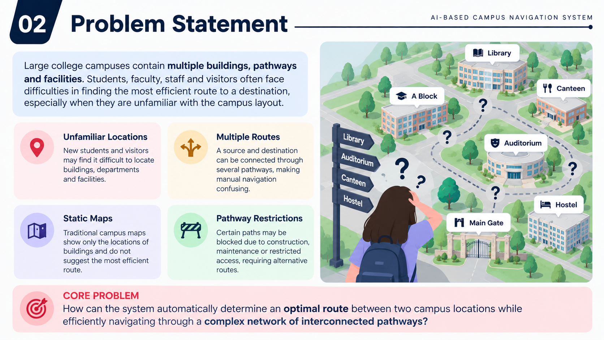
PROBLEM STATEMENT
Large college campuses contain multiple buildings, pathways, departments, and facilities. Students, faculty, staff, and visitors may face difficulty finding the most efficient route to a destination, especially when they are unfamiliar with the campus layout.
UNFAMILIAR LOCATIONS
MULTIPLE ROUTES
New students and visitors may find it difficult to locate buildings, departments, and facilities.
A source and destination can be connected through several pathways, making manual navigation confusing.
PATHWAY RESTRICTIONS
STATIC MAPS
Certain paths may be blocked due to construction, maintenance, or restricted access, requiring alternative routes.
Traditional campus maps show the locations of buildings but do not automatically suggest the most efficient route.

Slide 4
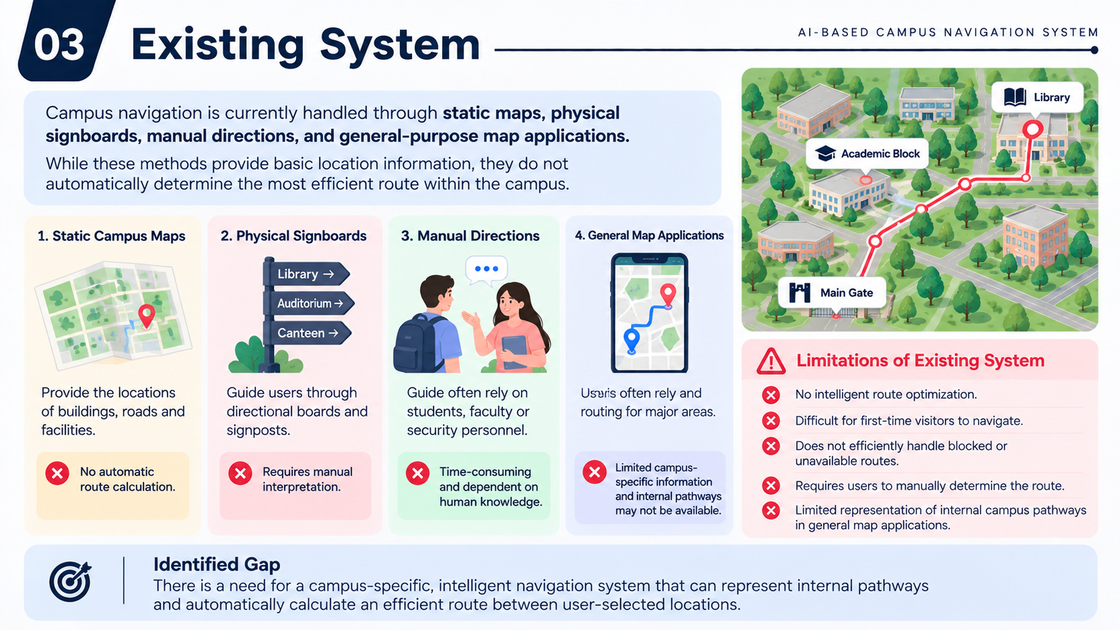

EXISTING SYSTEM
Campus navigation is currently handled through static maps, physical signboards, manual directions, and general-purpose map applications. While these methods provide basic location information, they do not automatically determine the most efficient route within the campus.
STATIC CAMPUS MAPS
MANUAL DIRECTIONS
PHYSICAL SIGNBOARDS
GENERAL MAP APPLICATIONS
LIMITATIONS OF EXISTING SYSTEM
Users depend on students, faculty, or security personnel for guidance.
Provide the locations of buildings, roads, and facilities.
Guide users through directional boards and signposts.
Provide digital navigation for major locations.
  No intelligent route optimization.
  Difficult for first-time visitors to navigate.
  Requires users to manually determine the route.
  Limited representation of internal campus pathways.
  Does not efficiently handle blocked or unavailable routes.
Time-consuming and dependent on human knowledge.
Requires manual interpretation.
Limited campus-specific information and internal pathways.
No automatic route calculation.
There is a need for a campus-specific, intelligent navigation system that represents internal pathways and automatically calculates an efficient route between user-selected locations.

Slide 5
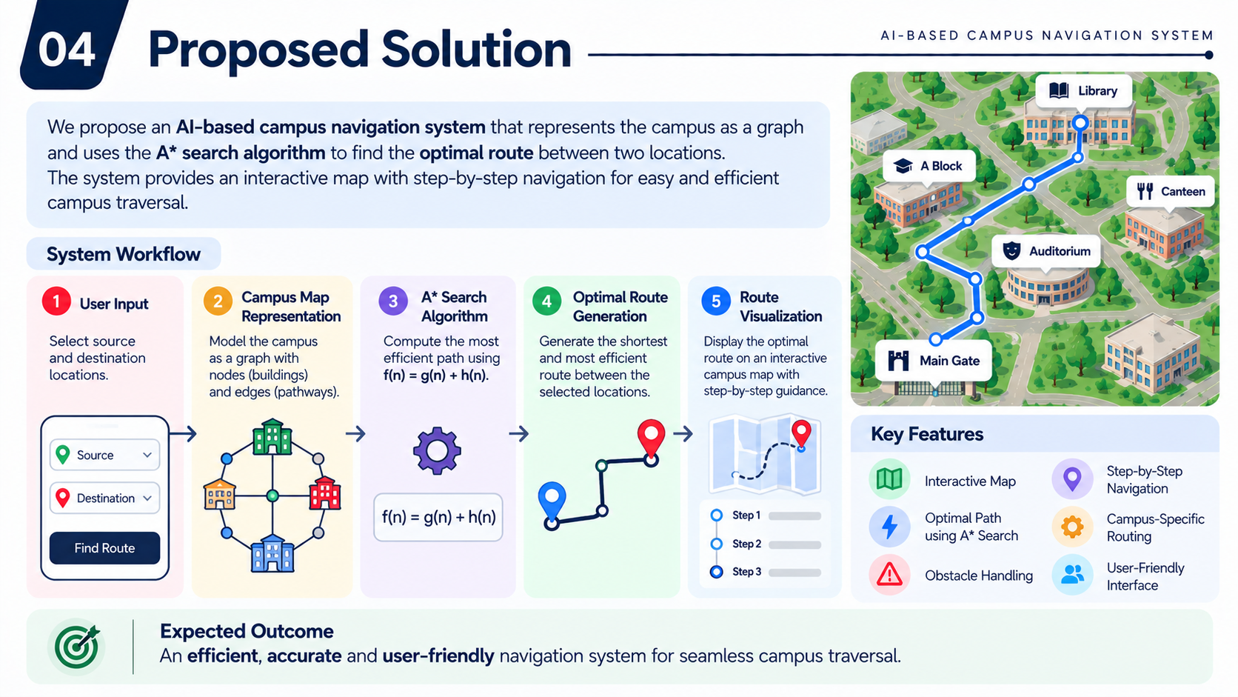
PROPOSED SOLUTION
We propose an AI-based campus navigation system that represents the entire campus as a graph of interconnected locations and uses the A* Search Algorithm to determine an optimal route between a selected source and destination.
SYSTEM OVERFLOW
USER INPUT
CAMPUS GRAPH REPRESENTATION
A* ROUTE SEARCH
OPTIMAL ROUTE GENERATION
ROUTE VISUALIZATION
The user selects the source and destination from the campus map.
Model the campus as graph with nodes as buildings and edges as paths
Compute the most effiecient path using f(n) =g(n) + h(n)
Generate the shortest and most effiecient route between te selected locations.
Display the optimal route on interactive campus map with step by step guidance

Slide 6
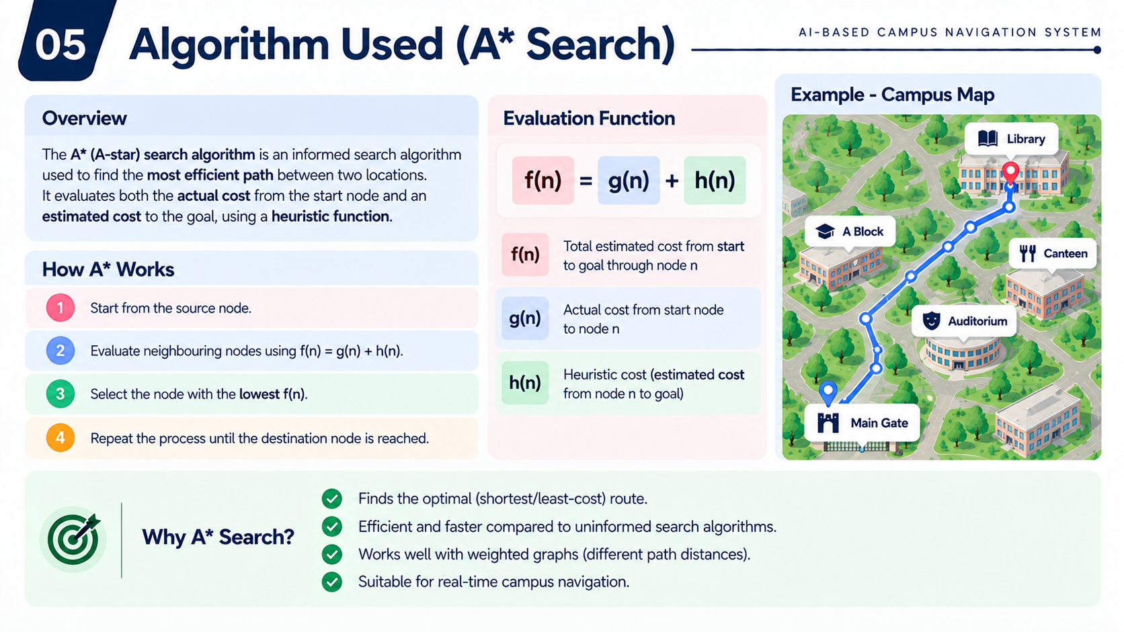
ALGORITHM USED
HOW THE ALGORITHM FINDS THE OPTIMAL ROUTE
EVALUATION FUNCTION
The A* algorithm searches through the campus graph by evaluating each possible node based on its actual travel cost and estimated distance to the destination.
f(n)
=
g(n)
+
h(n)
f(n)
Total estimated cost from start to goal through node n
HOW A* WORKS ?
g(n)
Actual cost from the start node to node n
1.
Start from the source node
Heuristic cost (estimated cost from node n to goal)
h(n)
2.
Evaluate the neighbouring nodes using f(n) = g(n) + h(n)
WHY A* SEARCH ?
  Finds the optimal (least-cost ) route
3.
Select the node with lowest f(n)
  Efficient and faster compared to uninformed search algorithm
4.
Repeat the process until the destination node is reached
  Suitable for real-time campus navigation
  Works well with weighted graphs

Slide 7
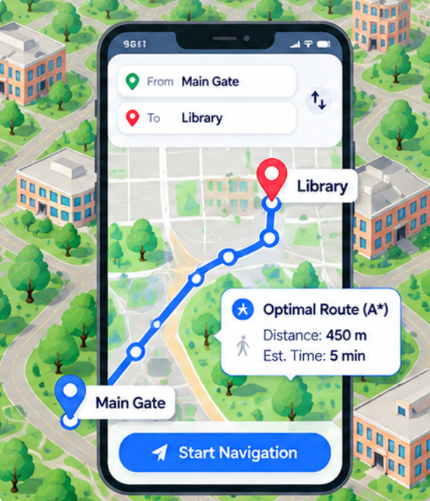



RESULT & CONCLUSION
Results
The proposed AI-based campus navigation system uses the A* Search Algorithm to identify an optimal route between two selected campus locations. The system provides a clear and interactive way to navigate through the campus.
Key Outcomes
Optimal Route
Finds the shortest or least-cost path between the selected locations.
Efficient Navigation
Reduces the effort and time required to manually determine a route.
Performance Metrics (Sample)
450 m
Total distance of optimal route
5 min
Estimated travel time
7
Nodes explored in the optimal path
Interactive Map
Provides a visual representation of campus locations and the calculated route.
Conclusion
Future Scope
The proposed AI-based campus navigation system using A* provides an efficient approach to solving campus pathfinding problems. By representing the campus as a graph and intelligently evaluating possible routes, the system can help users find suitable paths between different locations.
Real-time navigation with GPS integration
Multi-floor navigation for large buildings
Dynamic updates for blocked or restricted pathways
Integration with college apps and campus information
Voice-guided navigation for improved accessibility

